Slide 1
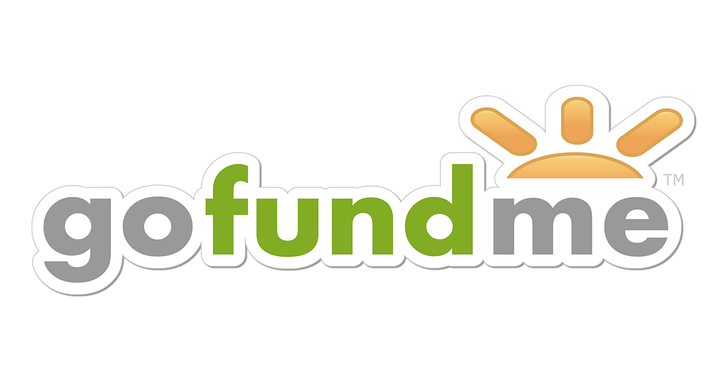
William Chen
Joseph Jaconetta
Ashley Choi
March 18, 2021 IST 300 - M002

Slide 2
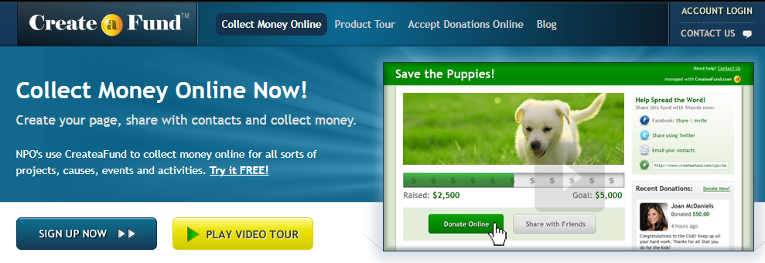
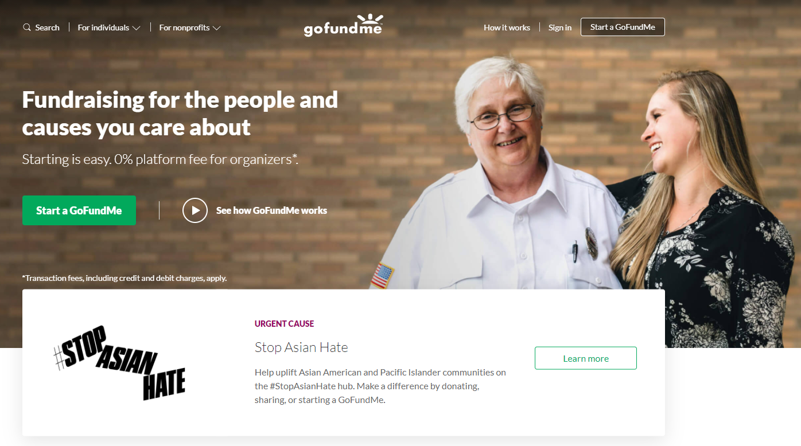
About GoFundMe
Crowdfunding platform to raise money for life events and charity events
Originally called CreateaFund (2008) but changed to GoFundMe in 2010
In 2017, GoFundMe became the largest crowdfunding platform
Raised over $9 billion since 2010
Founded by Brad Damphousse and Andrew Ballester

Slide 3
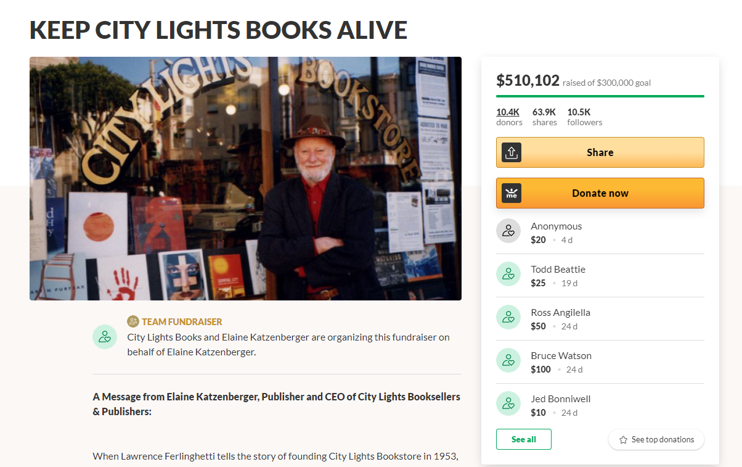
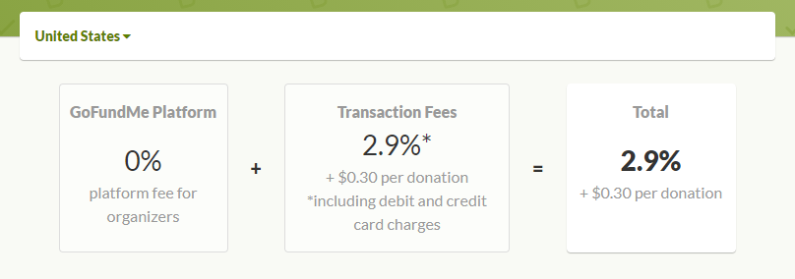
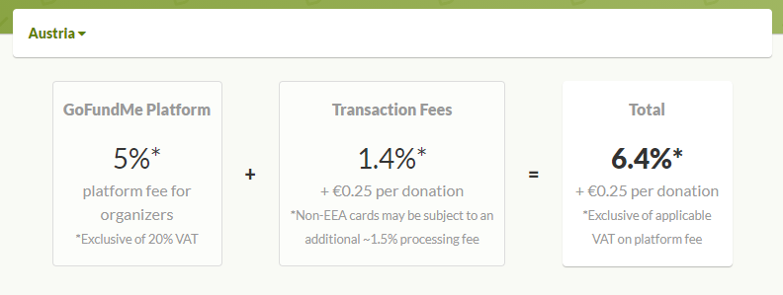
GoFundMe Business Model
User dependent
5% platform fee + 2.9% transaction fee per donation -> 2.9% + $0.30 transaction fee per donation
Create a fundraiser, share it, and comment on it

Slide 4
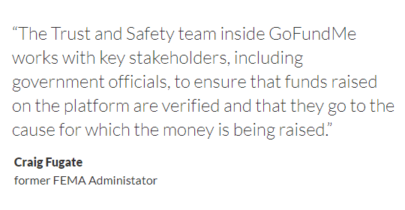
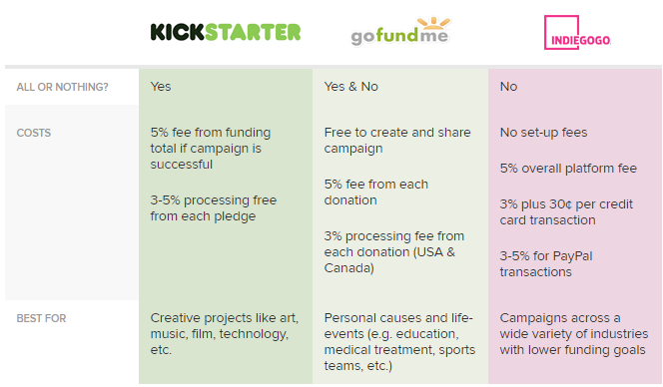
GoFundMe vs Competitors
Main competitors are Kickstarter and Indiegogo
GoFundMe: Keep however much you raise no matter if you hit the goal Kickstarter: If you don’t reach your goal, you don’t get the money Indiegogo: You pick which one you want to do
GoFundMe offers “donor protection guarantee”

Slide 5
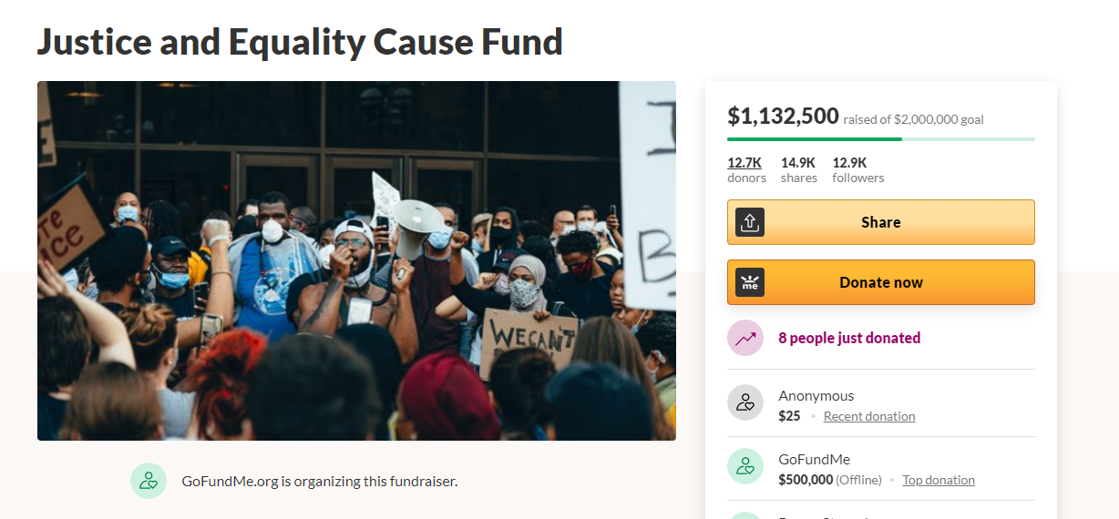
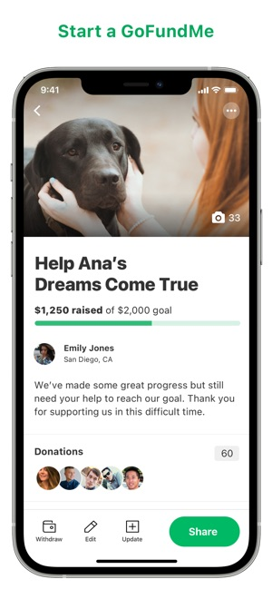
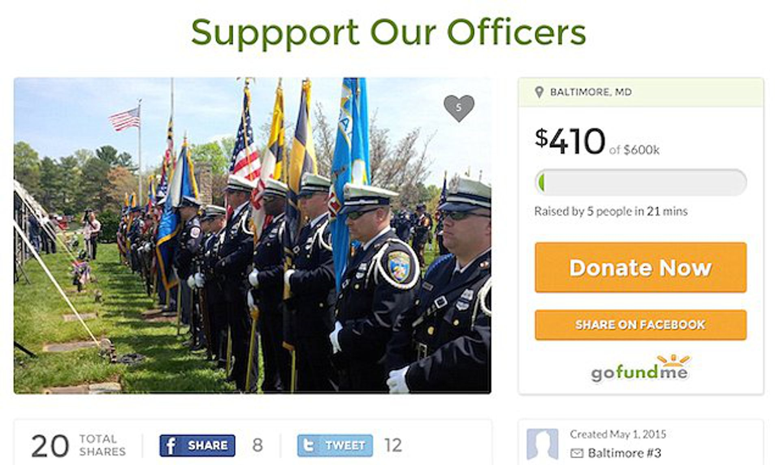
Scalability
Scaling on demand/autoscaling
Improved caching
Acquired CrowdRise in 2017
Fundraising for charities, events, and nonprofits
Started gofundme.org in 2019
Independent from gofundme.com and does charity work
Content is moderated
GoFundMe app

Slide 6
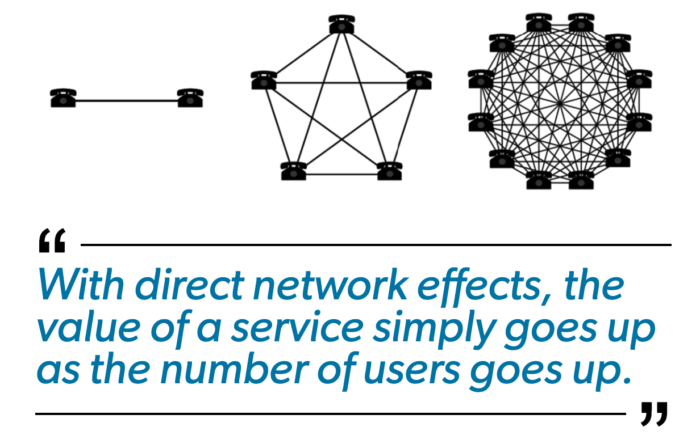
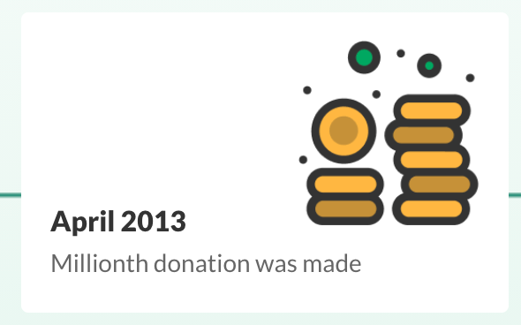
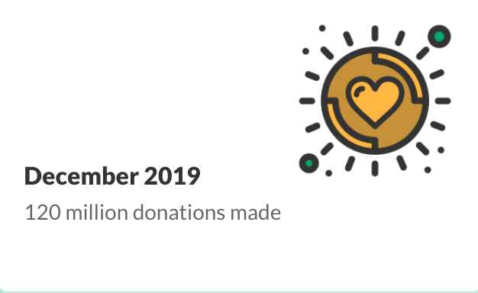
Network Effect
Direct network effect
Crowdfunding
User based platform
More users utilize the more profit GoFundMe makes creating value
Both parties benefit with more users
Added value from social media
value of a fundraiser who shares a GoFundMe page on social media raised an average of additional $15

Slide 7
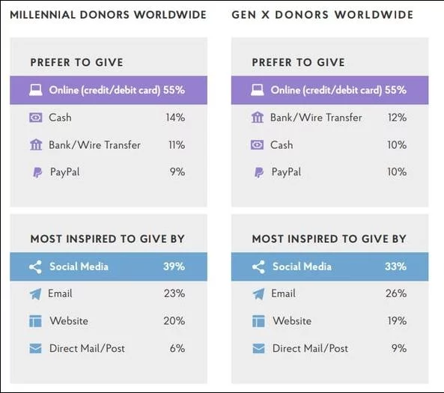
User-base Demographics
One billion visits from 491 million users in 2017
So, who utilizes GoFundMe?
Mobile-conscious users
households earned incomes between $40,000 to $120,000
Under the age of 45
Both women and men, especially women

Slide 8

Company Benefits
GoFundMe prides themselves on their collaborative, empathetic work environment
Awards:
2017 - Best Workplace in Technology
2017 - Best Workplace in Giving Back
2017 - Best Small/Medium Company in Bay Area
2016 - Best Medium Workplace
Gives Back Program: Employees nominate fundraisers weekly for donations
Gave back more than $500,000 in 2015
Provide employees with full medical, dental, and vision insurance options with 100% of premiums and an annual $600 fitness and wellness benefit.

Slide 9
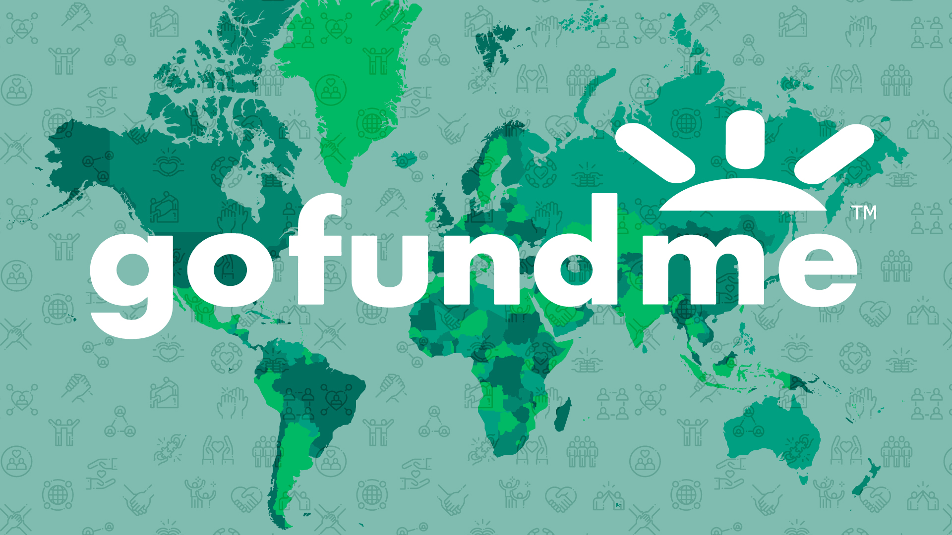
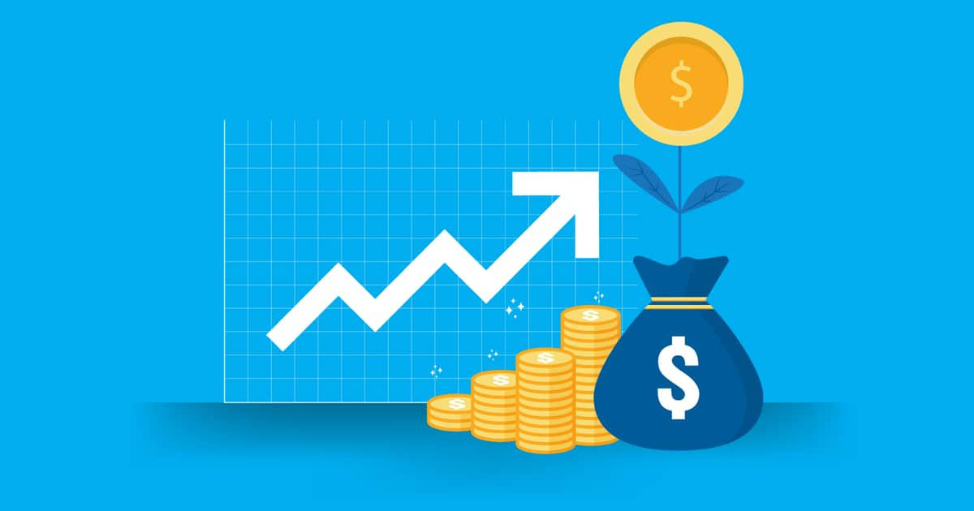
Revenue/Path to Profitability
Extremely secretive in disclosing revenue figures to the public
Only once - 2016 made $100 million in revenue
Makes money through transaction fees, platform fees before 2017, and direct donations.
Company was valued at $650 million in 2015 - Much higher now
Likely to be already profitable
Only about over ~500 employees

Slide 10
Why GoFundMe will Continue to Prosper
Is driven off of the good nature of others
From March 1 to Aug. 31, donors raised more than $625 million for COVID-19 pandemic relief
Only popular company that does what it does
Largest competitors are more for startups/products
Exponential growth:
Raised $3 Billion from 2010-2016; Up to $9 Billion by early 2020.
Meanwhile..
Peloton saw its losses nearly quadruple over the course of a single fiscal year, from a $47.9 million net loss in 2018 to a $245.7 million net loss in 2019
The fitness market has become oversaturated

Slide 11
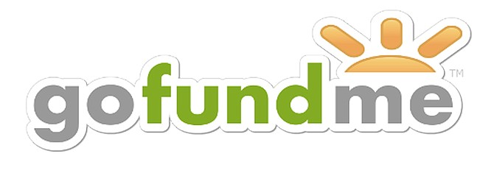
Thank You!
VOTE FOR
Any Questions?

Slide 12
References
https://www.cnbc.com/2018/04/14/gofundme-ceo-rob-solomon-our-insane-no-fee-business-model-works.html
https://grasshopper.com/resources/tools/crowdfunding-platforms-kickstarter-gofundme-indiegogo/#:~:text=Kickstarter%3A%20a%20platform%20that%20focuses,for%20individuals%20and%20personal%20causes.&text=No%20all%20or%20nothing%20requirement%2C%20but%20fees%20can%20be%20higher.
https://www.azcentral.com/story/money/business/consumers/2017/11/14/gofundme-how-it-works-makes-money-pays-you-prevents-fraud/859211001/
https://www.gofundme.com/pricing#US
https://en.wikipedia.org/wiki/GoFundMe#cite_note-6
https://www.fastcompany.com/3067472/how-crowdfunding-platform-gofundme-has-created-a-3-billion-digital
https://www.gofundme.org/
https://www.gofundme.com/2020
https://www.gofundme.com/c/about-us
https://www.gofundme.com/c/why-gofundme
https://www.gofundme.com/c/safety/gofundme-guarantee
https://support.indiegogo.com/hc/en-us/articles/526876-Refunds-Can-I-get-my-money-back-
https://help.kickstarter.com/hc/en-us/articles/115005048173-Does-Kickstarter-issue-refunds-
https://charity.gofundme.com/c/blog/tech-upgrades
https://techcrunch.com/2017/01/10/gofundme-buys-crowdrise-to-expand-to-fundraising-for-charities/
https://www.gofundme.com/f/JusticeAndEqualityFund
https://www.owler.com/company/gofundme
https://www.baltimoresun.com/news/crime/bs-md-ci-police-fund-20150502-story.html
https://www.prnewswire.com/news-releases/in-time-for-holidays-gofundme-introduces-a-0-platform-fee-for-personal-campaigns-in-the-us-300564758.html
https://www.thenonprofittimes.com/npt_articles/modest-income-donors-gravitate-gofundme/
https://nonprofithub.org/fundraising/crowdrise-data-report/
https://www.businessinsider.com/peloton-files-for-ipo-reveals-risk-factors-for-investors-2019-8
https://productmint.com/the-gofundme-business-model-how-does-gofundme-make-money/#:~:text=GoFundMe%2C%20in%20all%20likeliness%2C%20is,over%20its%2010%2Dyear%20lifespan.

